Slide 1
Quantum Fourier Transform
Discrete Fourier Transform, but in quantum…
不正经讲师：理科宅Hunt

Slide 2

Hadamard gate
Hadamard gate is to encode/decode(编码/解码) the information to a phase
Encode: $H\left|x\right\rangle =\frac{1}{\sqrt{2}}\sum_{y=0}^{1}{{\left(−1\right)}^{xy}|y⟩}$
Decode: $H\frac{1}{\sqrt{2}}\sum_{y=0}^{1}{{\left(−1\right)}^{xy}|y⟩}=\left|x\right\rangle$
Hadamard gate is good, but what if we want to encode/decode more complicated information to/from the phase??
We want to change the phase to a more general form $e^{iφ}$?

Slide 3
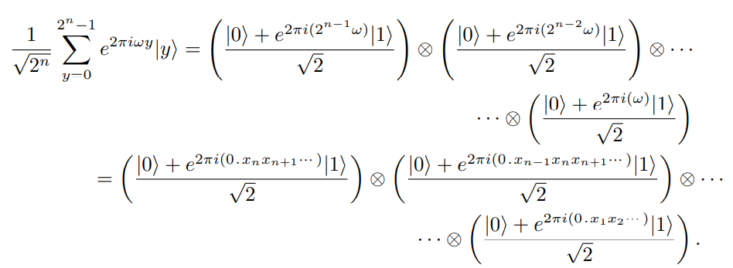
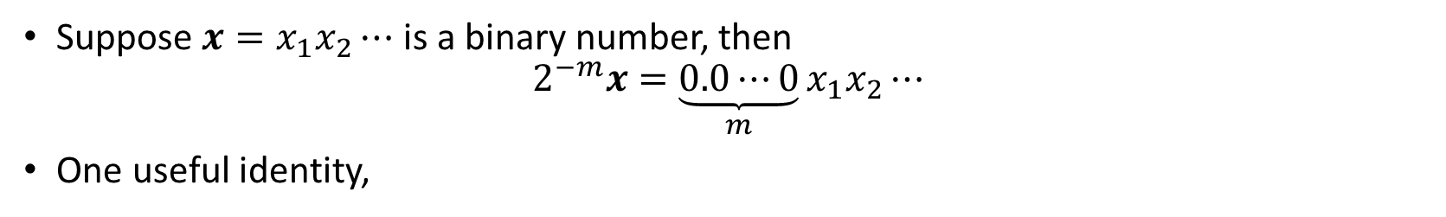
A useful notation and identity
Suppose $x=x_{1}x_{2}⋯$ is a binary number, then
$$2^{−m}x=\underset{m}{\underbrace{0.0⋯0}}x_{1}x_{2}⋯$$
One useful identity,

Slide 4
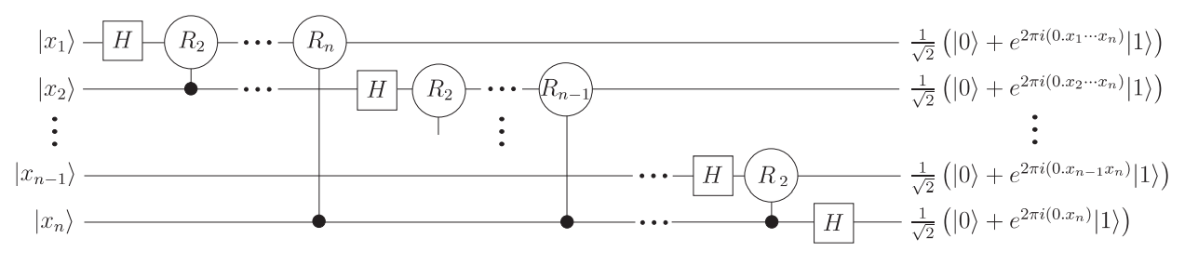

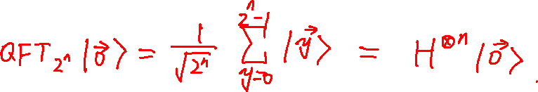
Quantum Fourier Transform
$$QFT_{2^{n}}\left|x\right\rangle =\frac{1}{\sqrt{2^{n}}}\sum_{y=0}^{2^{n}−1}{e^{2πi\frac{x}{2^{n}}⋅y}|y⟩}$$

Slide 5


What is $R_{k}$??
$R_{k}$ is a rotation matrix,
$$R_{k}=\left[\begin{matrix}1 & 0 \\ 0 & e^{2πi/2^{k}}\end{matrix}\right]=\left[\begin{matrix}1 & 0 \\ 0 & e^{2πi(\underset{k}{\underbrace{0.0⋯0}}1)}\end{matrix}\right]$$
The action of it is
$$R_{k}\frac{\left|0\right\rangle +\left|1\right\rangle }{\sqrt{2}}=\frac{1}{\sqrt{2}}\left[\begin{matrix}1 & 0 \\ 0 & e^{2πi(\underset{k}{\underbrace{0.0⋯0}}1)}\end{matrix}\right]\left[\begin{aligned}1 \\ 1\end{aligned}\right]=\frac{\left|0\right\rangle +e^{2πi(\underset{k}{\underbrace{0.0⋯0}}1)}\left|1\right\rangle }{\sqrt{2}}$$
That means $R_{k}$ puts 1 into k-th “decimal” place (keep in mind these numbers are binary).

Slide 6

Inverse Quantum Fourier Transform
$$QFT_{2^{n}}^{−1}\left|x\right\rangle =\frac{1}{\sqrt{2^{n}}}\sum_{y=0}^{2^{n}−1}{e^{−2πi\frac{x}{2^{n}}⋅y}|y⟩}$$

Slide 7
Summary
QFT is to encode information to the phase
Inverse QFT decodes information from the phase
We’ll use QFT in Shor’s algorithm

